Slide 1
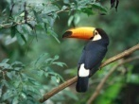
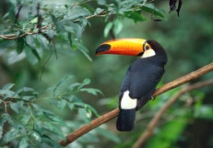

PhotoStore
!!
$
$
$$$
?
Gallery

Slide 2
The flow
Watcher
instance data.input
schema image
data image
mgx
Photo.m
instances.m
m
grammar.mgx
mx
mg
grammar

Slide 3
Security
Watcher
ReaderWriter
Folder 1
Folder 100
Reader
$$$
Administrator
Grant permissions

